Slide 1

Boost Sales with Shopping Feed Management
Strategies to enhance your e-commerce performance
Yossi Elchanan
CMO
Adcore.com
Notes:
---
Welcome to our presentation on boosting sales through effective shopping feed management. Today we will explore essential strategies and techniques that can optimize your e-commerce performance. I'm Yossi Elchanan, the CMO, and I'm excited to guide you through this 2024 guide.

Slide 2

Introduction to Shopping Feed Management
Importance of Shopping Feed Management
  Effective shopping feed management is crucial for boosting product visibility and sales in the competitive e-commerce landscape.
Performance Enhancement
  Proper management of product feeds leads to improved performance metrics, such as conversion rates and return on investment.
Key Topics Overview
  This presentation will cover essential topics related to shopping feed management, providing a comprehensive understanding of its benefits.
Notes:
In this opening slide, we'll discuss the critical importance of shopping feed management in e-commerce. With the right management of product feeds, businesses can enhance visibility and performance across various online platforms. Let's outline the key topics we will cover today.

Slide 3

What is Shopping Feed Management?
Definition of Shopping Feed Management
  Shopping feed management is the process of organizing and optimizing product data for online retail platforms, ensuring effective representation of products.
Importance of Optimization
  Optimizing shopping feeds enhances search relevance, allowing potential customers to find products more easily, which can boost visibility.
Impact on Sales Performance
  Effective shopping feed management improves sales performance by making it easier for customers to discover and purchase products.
Notes:
Shopping feed management involves the organization and optimization of product data for various e-commerce platforms. This practice is significant as it ensures search relevance, helping potential customers find your products more easily, ultimately improving sales performance.

Slide 4

Key Elements for Success
Accurate Categorization
  Accurate categorization of products is crucial for enhancing search visibility, making it easier for customers to find products.
Optimized Product Feeds
  Optimized product feeds should include compelling titles, descriptions, and high-quality images to effectively attract and engage customers.
Notes:
To achieve success in shopping feed management, two key elements must be prioritized: accurate categorization, which enhances search visibility, and optimized product feeds that include compelling titles, descriptions, and high-quality images to attract customers.

Slide 5

Steps to Optimize Your E-Commerce Strategy
Tailored Product Feeds
  Customizing product feeds to meet the specifications of platforms like Google Shopping and Amazon boosts visibility and sales.
Enhanced Content
  Creating appealing titles and detailed descriptions helps attract and engage potential buyers, leading to higher conversion rates.
Visual Appeal
  Eye-catching visuals are essential for online products, as they significantly enhance user interest and purchase likelihood.
Notes:
Optimizing your e-commerce strategy starts with tailoring your product feeds to specific platform specifications, such as Google Shopping or Amazon. Additionally, enhancing content with appealing titles, detailed descriptions, and eye-catching visuals is vital for engaging potential buyers.

Slide 6

Overcoming Common Challenges
Monitoring Feed Errors
  E-commerce businesses must monitor shopping feed errors closely to ensure smooth operations and customer satisfaction.
Using Management Tools
  Utilizing tools for shopping feed management helps businesses track, correct errors, and streamline their operations.
Dynamic Updates Implementation
  Implementing dynamic updates allows for real-time adjustments in inventory and pricing, enhancing customer experience.
Notes:
E-commerce businesses often face challenges in shopping feed management. Monitoring feed errors is crucial; using tools can help track and correct issues promptly. Furthermore, implementing dynamic updates ensures that inventory and pricing remain accurate in real time.

Slide 7
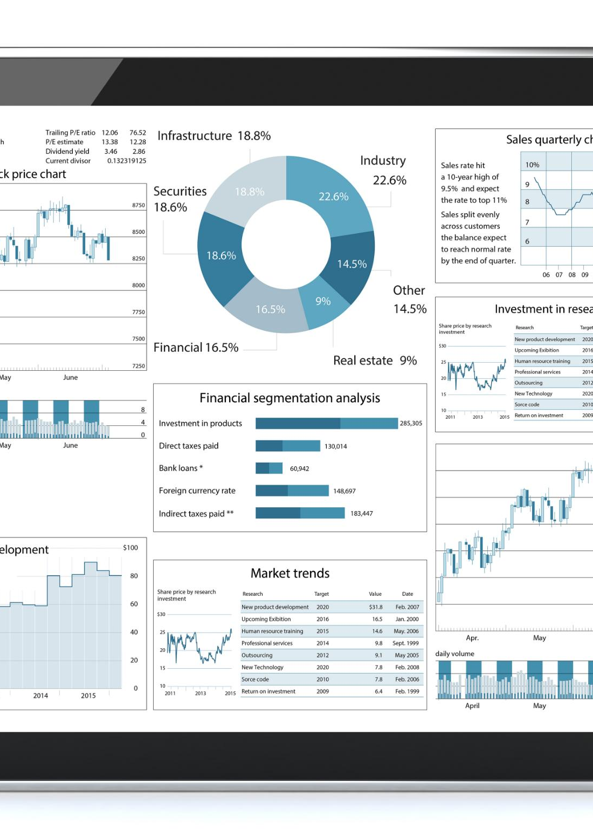
Advanced Feed Management Techniques
Automation Tools
  Utilizing automation tools in feed management saves time and significantly boosts operational efficiency for businesses.
Data-Driven Insights
  Leveraging analytics in feed management provides crucial data-driven insights that help refine strategies for improved performance.
A/B Testing for Optimization
  A/B testing allows businesses to evaluate different strategies, leading to more effective feed management decisions based on performance data.
Notes:
For businesses looking to enhance their feed management, advanced techniques can be beneficial. Utilizing automation tools saves time and boosts efficiency. Additionally, leveraging analytics and A/B testing provides data-driven insights that refine feed strategies for better performance.

Slide 8

Impact on E-Commerce Success
Boosting Sales
  Optimized shopping feed management significantly increases sales by ensuring products are easily discoverable online.
Enhancing Revenue
  Effective feed management strategies enhance revenue by improving product visibility and driving more qualified traffic to e-commerce sites.
Return on Investment
  Investing in proper feed management leads to a higher return on investment through better product placement and increased conversions.
Notes:
Effective shopping feed management directly impacts e-commerce success by boosting sales and enhancing revenue and return on investment. In this slide, we will discuss real-world examples that demonstrate measurable results achieved through optimized feed management.

Slide 9
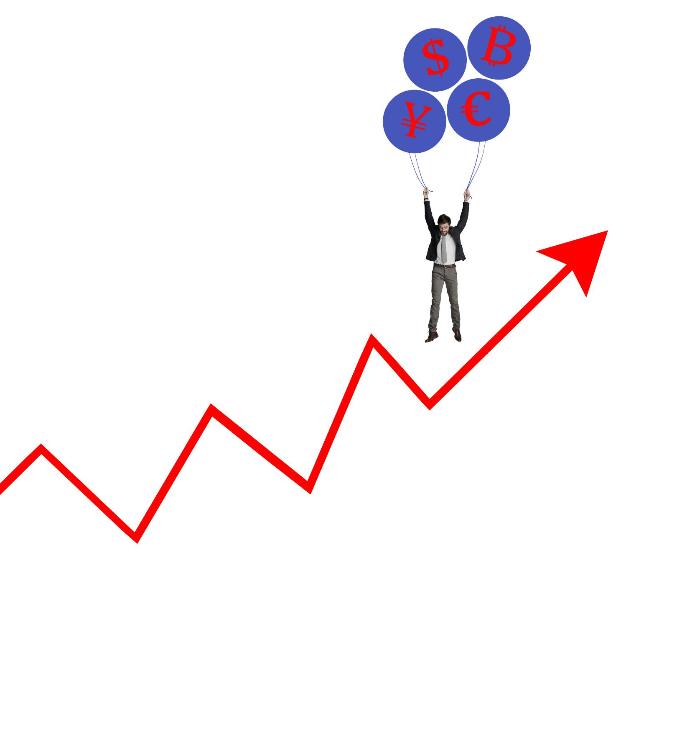
Case Studies
Optimized Feeds and ROI
  This case study highlights how businesses achieved significant ROI growth by optimizing their product feeds.
Scaling Sales Across Platforms
  This example illustrates a company's success in scaling its sales across multiple online platforms effectively.
Notes:
In this section, we will present case studies showcasing specific examples of businesses that have achieved significant ROI growth through optimized feeds. Another example will highlight how a company successfully scaled sales across multiple platforms.

Slide 10

Q&A
Open Floor for Questions
  We welcome all questions related to shopping feed management to enhance understanding and clarity.
Comprehensive Answers
  I will provide thorough and detailed responses to ensure clarity on the topics discussed.
Notes:
Now we will open the floor for questions. Please feel free to ask any questions related to shopping feed management, and I will do my best to provide comprehensive answers.

Slide 11

Summary and Key Takeaways
Shopping Feed Management
  Effective shopping feed management is crucial for enhancing product visibility and maximizing sales in e-commerce.
Key Elements for Success
  Understanding key elements such as product data quality and feed optimization leads to successful e-commerce strategies.
Techniques to Optimize Strategy
  Utilizing various techniques can significantly optimize your shopping feed strategy and improve online performance.
Impact on E-commerce Success
  A well-managed shopping feed positively impacts overall e-commerce success, driving traffic and conversions.
Notes:
To conclude our session, let's summarize the key takeaways from today's presentation. We discussed the importance of shopping feed management, key elements for success, techniques to optimize your strategy, and the positive impact it can have on e-commerce success.

